Slide 1
Environmental Justice & Climate Change
“It represents one of the principal challenges facing humanity in our day
(Laudato Si’ 25)”
Fray Eduardo Agosta Scarel, O. Carm.
eduardo.agosta@gmail.com
Notre Dame Seminary
New Orleans, February 2019

Slide 2
Goals
What is (not) the Encyclical
Climate Change
What to do.

Slide 3
Former Popes’ concerns on Ecology
Within the Church, since the Council Vatican II there’s been a progressive understanding of environmental and ecological issues, as we human being through science and technology learn more about the consequences of our activities.
Back in 1970, the Pope Paul VI warned about the consequences of a concept of development that is insensitive to its impact on the natural environment:
“But the carrying out of these technical possibilities at an accelerated pace is not accomplished without dangerous repercussions on the balance of our natural surroundings. The progressive deterioration of that which has generally come to be called the environment, risks provoking a veritable ecological catastrophe. Already we see the pollution of the air we breathe, the water we drink. We see the pollution of rivers, lakes, even oceans - to the point of inspiring fear of a true «biological death» in the near future, if energetic measures are not immediately and courageously taken and rigorously put into practice. It is a formidable prospect which you must diligently explore in order to save from destruction the fruit of millions of years of natural and human selection. ."
He added,
"In brief, everything is bound up together. You must be attentive to the great consequences which follow on every intervention by man in the balance of nature, whose harmonious richness has been placed at his disposal in accordance with the living design of the Creator"
Speech during visit of Pope Paul VI to F.A.O. on the 25th Anniversary of its creation, Nov 16 1970 (#3).

Slide 4
Concerns on Ecological issues
In the Church, gradually, Justice and Peace opened up to Integrity of Creation, as a new horizon, as never done before, to take care of creation, to integrate the created things as an inherent part of the human life dignity for all human beings
Based on great work done by former Popes, Popes Francis has given us a gift.
He has taught us the link between Spirituality and the Care for Creation.
It is a matter of knowing how to read the sign of the times: in hope or in distress.

Slide 5
What’s not Laudato Si’?
The Pope encyclical “Laudato Si’” does not provide technical guidance on how to allocate user rights for the environment.
It is NOT a how-to guidance in looking for solutions.
Though, it pays great attention to what earth sciences have to tell.
However, Pope Francis sheds more light upon the ethical dimension of the Ecological problem and can provide us, thus, fundamental principles to be applied for solutions, besides Science:

Slide 6
What the Encyclical does offer:
Fundamental principles to take actions
The preferential option for the poor, the most vulnerable of our global actions against nature
Inter- and intra-generational justice; in the core of his encyclical Francis questions: “What kind of world do we want to leave to those who come after us, to children who are now growing up?
Common but differentiated responsibility, among the nations. We are all in charge of looking for solutions, but no evenly responsible.
Orientation to the common good in order to preserve nature and guarantee social Justice.

Slide 7
LS brings forth ethical lights on:
The universal destination of goods, contradicted by excessive consumerism in some countries that becomes impossible to generalize.
The care of what is fragile and weak against the overwhelming spirit of modern man. In this respect, care for the environment and the option for the poor go together like two realities that do not appear as economically profitable and does not go in line with the immediate revenue.
Following this line, a deep critique of the techno-economic paradigm that currently rules the world and that can only lead to different ecological and social crisis.
Human ecology and cultural ecology (the preservation of cultural diversity)
A spirituality that clearly incorporate the value of sobriety and sense of profound union with everything that exists.

Slide 8
First paragraphs of Laudato Si’
The earth as “our sister and mother earth” (LS 1)
A kind of family intimacy with nature, something not seen before with such mystical nuances.
Francis provides subjectivity to the Earth: it has a voice that cries out on account of the damage done by human beings (LS 2).
She “groans and suffers the pains of delivery (Rm 8,22).
The Bible also offers support to our origins: “we too are earth”, (cf. Gen 2,7)

Slide 9
Francis rejects the “biblical” language of “domination” (LS 63-64).
In Genesis, the environment of the earth is further presented using the metaphor of “the garden”,
in which “God places the human being” “to cultivate it and care of it” (Gn 2:15).
Therefore, human relationships with Nature, with the environment on Earth should be in such a manner as that work done by a steward. We were God’s stewards in the origins.
Stewardship means the conscious and responsible management of something entrusted to one's care. We were instructed to "care of and till" God's Creation (Gn 2:15).

Slide 10
Integral Ecology
Francis offers a metaphorical understanding using the concept of “integral ecology”
This demands new categories that go beyond:
“the language of mathematics, or of biology and connect us to the essence of what is human.” (LS 11).
Francis is opening the door to the language of the spirit: To the Spirituality of Integral Ecology.

Slide 11
SPIRITUALITY OF INTEGRAL ECOLOGY
Spirituality can be understood as that way and beliefs that guide the fundamental options and decisions of life, a new way, that gives rise to an alternative life-style, distinct from the dominant culture of consumerism and waste .
Ecology can be understood as the deep understanding or knowledge of the right relationships present in the environment and life enclosed by it, which allows a balanced and healthy deployment of the potentialities of life in that geography.

Slide 12
Contemplation, horizon of Spirituality
“Everything is interconnected, and this invites us to develop a spirituality of that global solidarity which flows from the mystery of the Trinity” (LS 240).
Contemplation is not a static dynamism, but the inner human space where spirituality expands upon creation.
The spiritual and the physical dimensions of reality can be regarded through the Trinitarian dynamism:
The Divine Power, the Humanness and the (other) Created Things (both visible and invisible), in mutual interpenetration, being the Divine Power, the Spirit of God, the enveloping and sustaining source of reality.
The oblivion of God

Slide 13
Environment, space of contemplation
#9: … As Christians, we are also called “to accept the world as a sacrament of communion, as a way of sharing with God and our neighbours on a global scale. It is our humble conviction that the divine and the human meet in the slightest detail in the seamless garment of God’s creation, in the last speck of dust of our planet”…
#11: … If we approach nature and the environment without this openness to awe and wonder, if we no longer speak the language of fraternity and beauty in our relationship with the world, our attitude will be that of masters, consumers, ruthless exploiters, unable to set limits on their immediate needs. By contrast, if we feel intimately united with all that exists, then sobriety and care will well up spontaneously…
#84: …The entire material universe speaks of God’s love, his boundless affection for us. Soil, water, mountains: everything is, as it were, a caress of God…

Slide 14
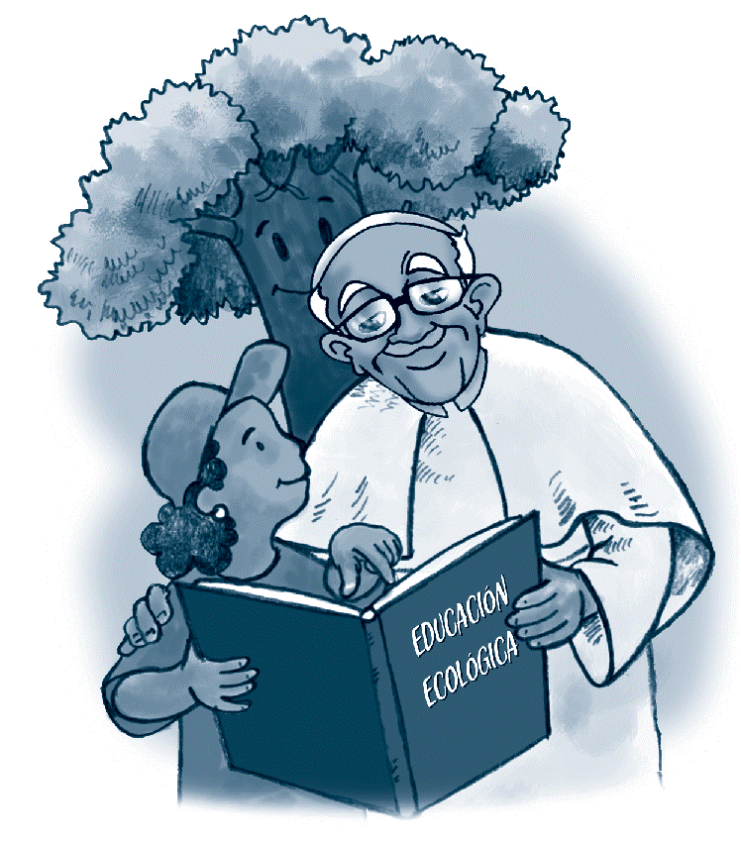
LS 83, the turning point
“The ultimate destiny of the universe is in the fullness of God, which has already been attained by the risen Christ, the measure of the maturity of all things. Here we can add yet another argument for rejecting every tyrannical and irresponsible domination of human beings over other creatures. The ultimate purpose of other creatures is not to be found in us. Rather, all creatures are moving forward with us and through us towards a common point of arrival, which is God, in that transcendent fullness where the risen Christ embraces and illumines all things.
Human beings, endowed with intelligence and love, and drawn by the fullness of Christ, are called to lead all creatures back to their Creator.”

Slide 15
Integral Ecology, a paradigm of relationships
Integral ecology should not be simply assumed as a spirituality.
Francis poses us into a new understanding of human relationship with Nature.
He wants us to pass from an image of the human being as a sovereign ruler over the rest of creation, to another paradigm of a universal intimate Family –
In solidarity with weak and marginalized people and living beings in danger of extinction.

Slide 16
The new paradigm
Requires faith:
“While this encyclical opens up a dialogue with all, to seek paths of liberation together, I want to show from the beginning how the convictions of the faith offer Christians, and in part also to other believers, great motivations for the care of the nature and of the most fragile brothers and sisters ". (LS 64)

Slide 17
Convictions of faith to heal the Planet
"The entire material universe is a language of God's love, of his excessive affection towards us. The soil, the water, the mountains, everything is the caress of God " (LS 84).
Francis is convinced that: "To perceive each creature singing the hymn of his existence is to live joyfully in the love of God and in hope" (LS 85).
From this core of convictions, the Pope assumes the call to peace, to justice and to the preservation of the created.
The central message of the Pope is, consequently, his profound experience of love for God through each creature and the poor.

Slide 18
Need of Mysticism
LS 25: «When someone does not learn to stop to perceive and value the beautiful, it is not strange that everything becomes for him an object of unscrupulous use and abuse»

Slide 19
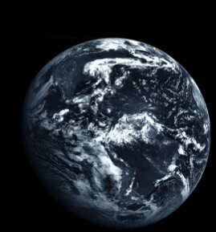
Chapter 1, LS: the Sate of the Earth
To see: through the tools of Science
To judge
To act

Slide 20
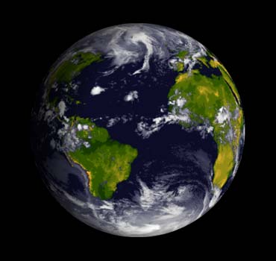
GROWTH OF THE WORLD POPULATION INEQUALITY (80% / 25%, wealth and equity)
Inequity affects not only individuals but entire countries, LS
Climate change
(700/500/400 ppm, uncertainty)
Biodiversity loss
(plus 40% already lost)
It represents one of the principal challenges facing humanity in our day, LS
The great majority become extinct for reasons related to human activity. Because of us, thousands of species will no longer give glory to God by their very existence, LS
Ecological crisis is a human matter
Energy shortage/depletion
(Decoupled prosperity of CO2)
substituting for fossil fuels and developing sources of renewable energy. Worldwide there is minimal access to clean and renewable energy. LS

Slide 21
The Earth, finite place
The GOODS of the earth are limited and are under the law of entropy.
1
All human activity consumes goods and reduces possibilities irreversibly.
2
Urgency in establishing priorities in the use of sources of usable energy and land goods, for activities that have a positive impact on the flourishing of present and future communities.
3

Slide 22
Challenges.
Fix the Economy.
Efforts oriented towards the rational management of natural goods and the generation of technology that helps generate long-term economic benefits (Circular Economy)
1
Preserve energy.
Rational use of energy sources by assigning priorities to human activities, in order to provide more possibilities for development for future generations and for more people today.
2
Fix the social logic.
Still today it is based on the culture of consumerism and the erosion of social and individual commitment.
3
The real and present danger is to delude ourselves with the possibility, thanks to technological magic, of an economy of infinite growth with immediate gain and the saving of the earth's resources, all at the same time. Tim Jackson, in Prosperity without growth

Slide 23
Climate Change
A warming Planet

Slide 24
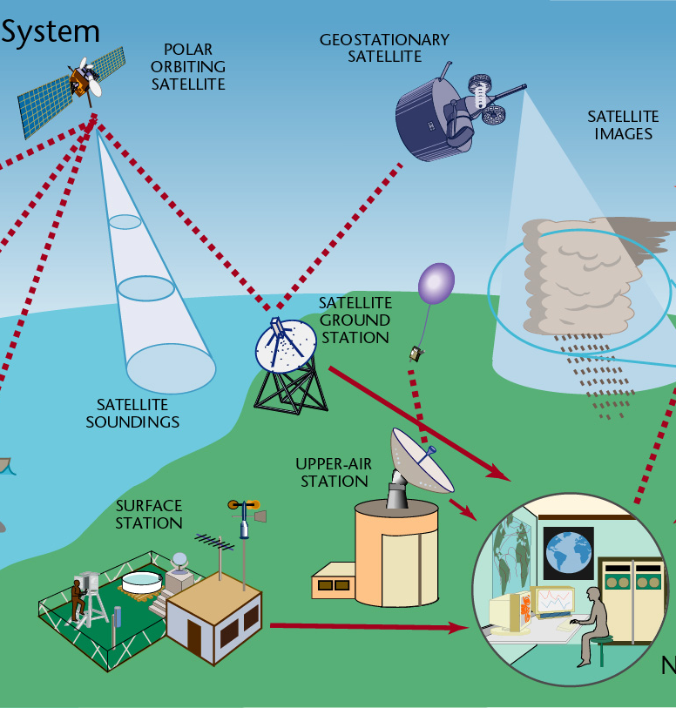
1. What is climate change?
An imbalance of energy, with a gain in favor of the Earth’s climate system (air, seas, ice, rivers, lakes, biomes, etc.).
2. How do we know?
We can measure it:
Since 2000, satellites can measure how much energy enters the earth from space (from the sun, mainly), and how much energy the earth emits into space.
The net energy balance: this gain is near 1 watt per meter square per year;
It means more heat flowing through the climate system.

Slide 25
3. How do we know it is our responsibility?
Very “cool” scientific papers have shown that GHG concentrations are forcing the energy imbalance
Basic physical concepts known from 1800: radiation equilibrium temperature, Wien’s law, Planck’s law.
Recently increasing lighter carbon isotopes records (from fossils) with respect to the biological heavier records
Reduction of oxygen molecules due to combustion.
Climate models are cute to prove global warming.
It is evident from historical and paleoclimatic records (proxy data) such ice cores, tree rings.

Slide 26
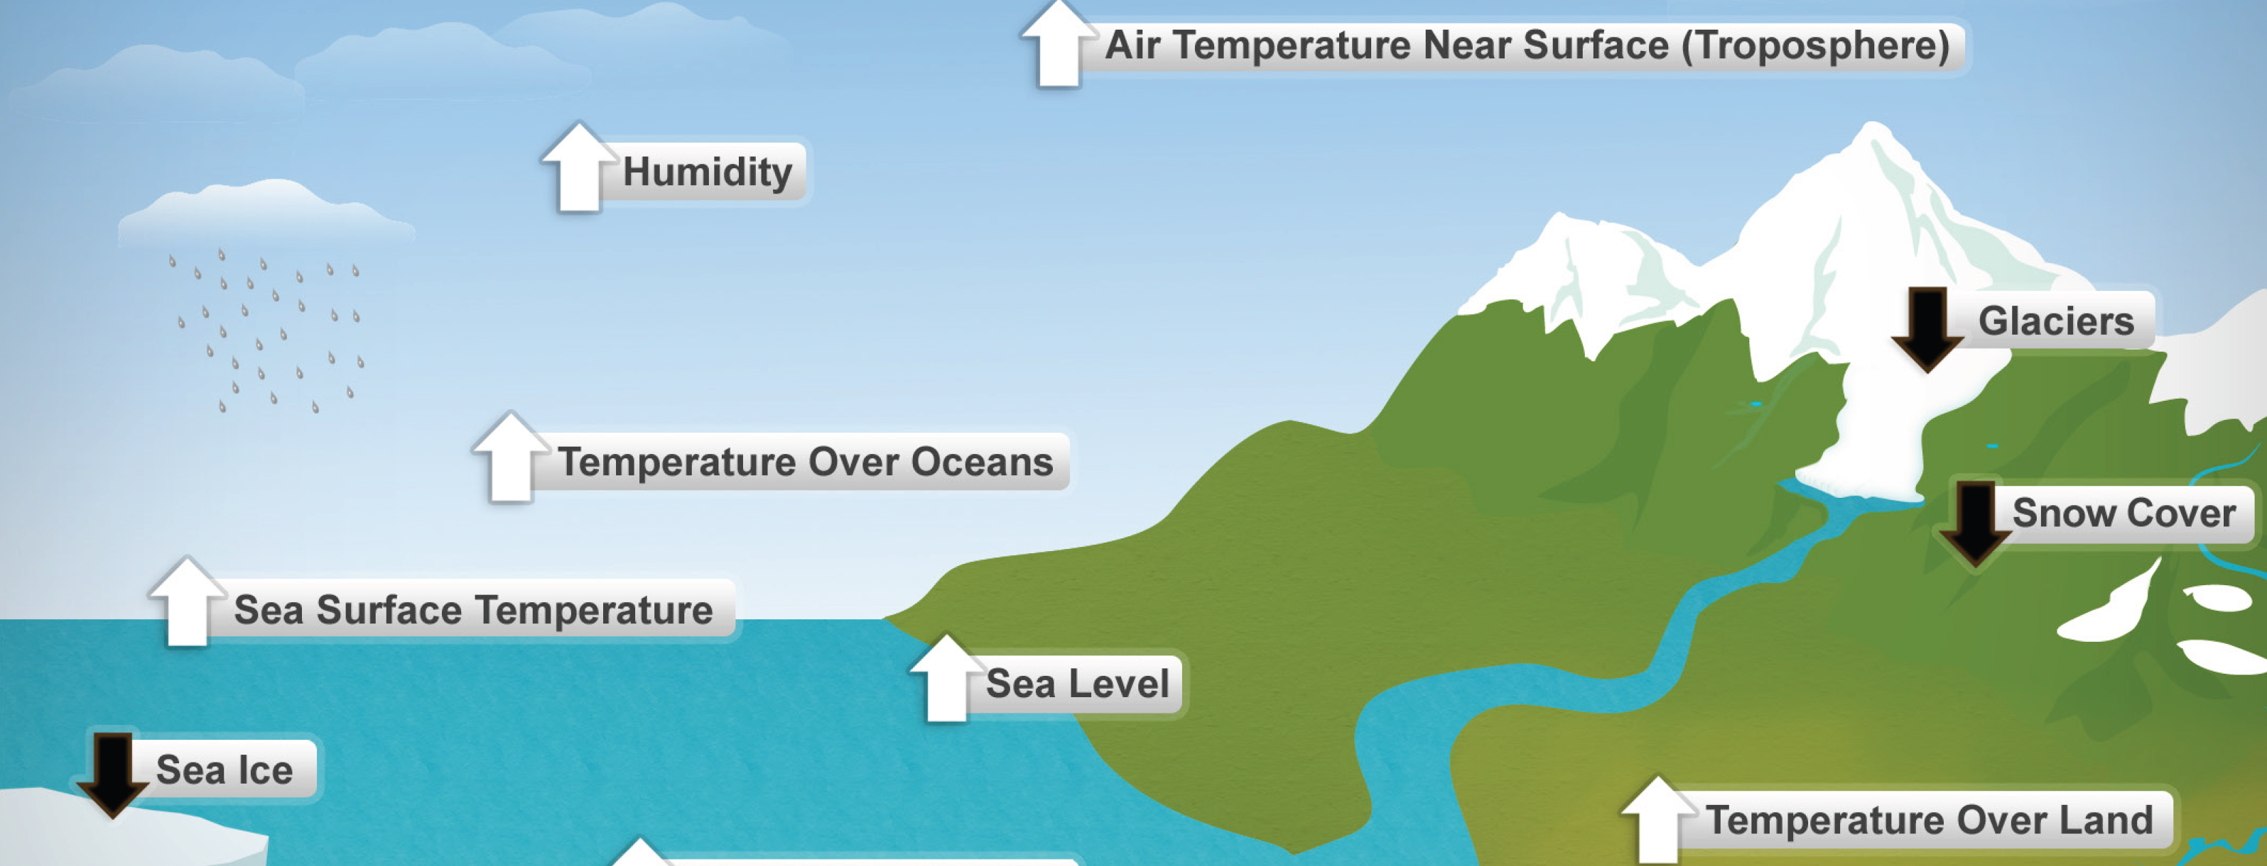
A Warming Climate
Schematic of those climate elements that would globally change in a context of global warming
Each of these indicators are observed and consistently give the heating pattern.

Slide 27
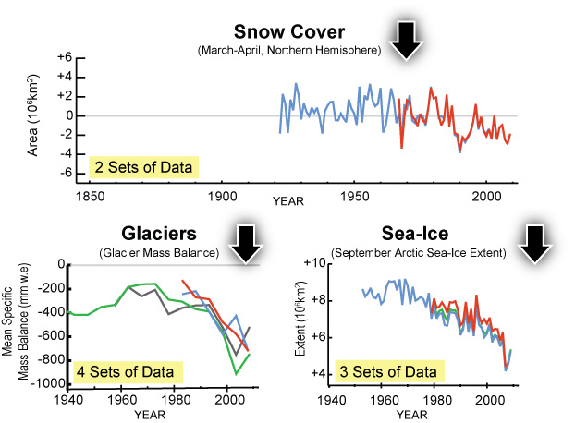
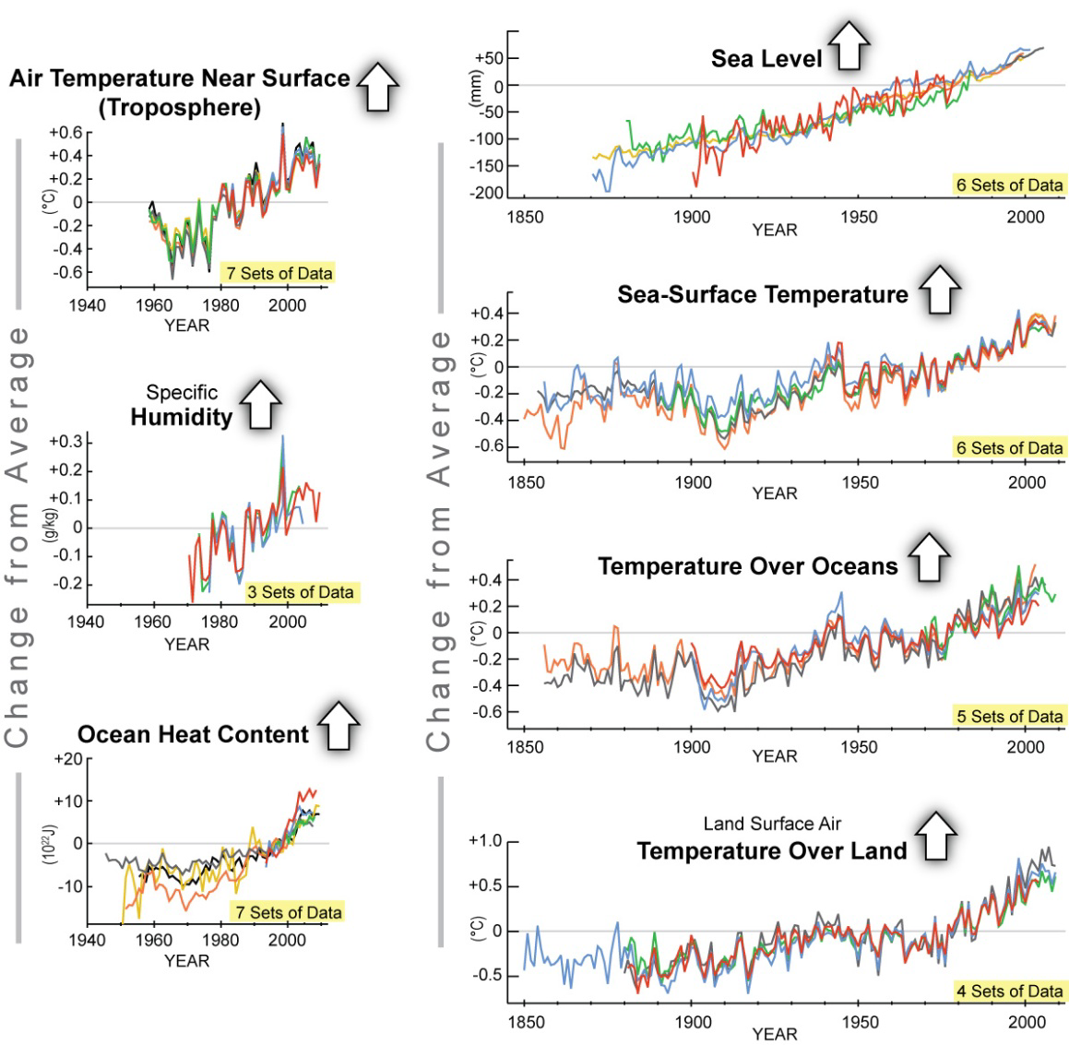
Ten warming indicators
(SOC 2009).

Slide 28
Global surface temperature anomaly against pre-industrial period, 1881-2018,
2016

Slide 29
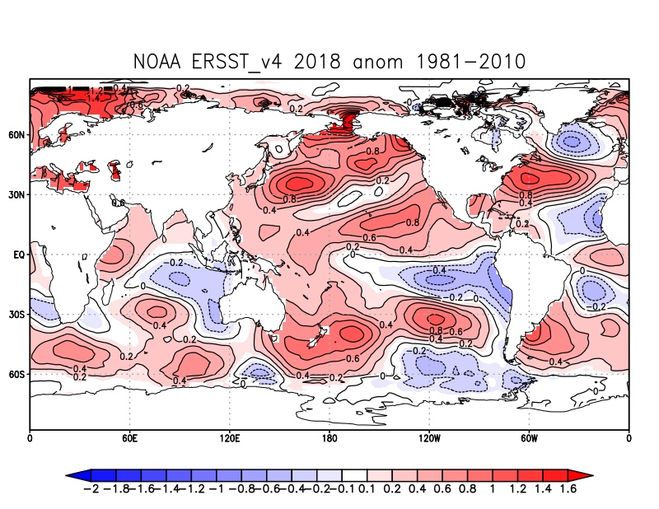
Global anomalies of air and sea temperature, 2018

Slide 30
In 2018 there is a peak of heat stored in the ocean

Slide 31
In 2013 scientists estimated that the accumulation of caloric energy stacked in the western Pacific would eventually be broken at any time The effect was precisely the El Niño 2015: the most intense in history
Some people call it “super Niño”.
Now in 2018 energy is being accumulated again

Slide 33
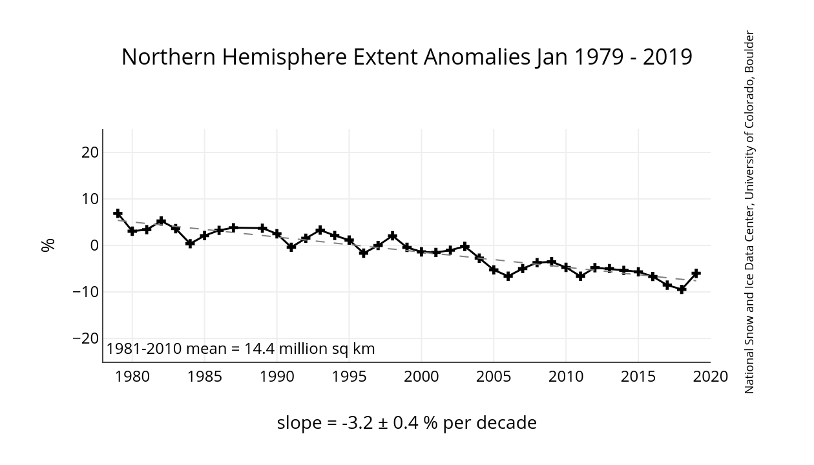
Sea Ice extent

Slide 35
Global sea level rise
SEA LEVEL RISE IS NOT EVENLY DISTRIBUTED. THERE ARE PLACES MORE AFFECTED THAN OTHERS, SUCH AS THE WESTERN EQUATORIAL PACIFIC BASIN.

Slide 36
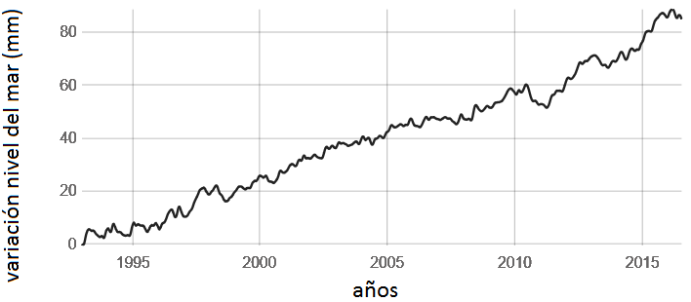
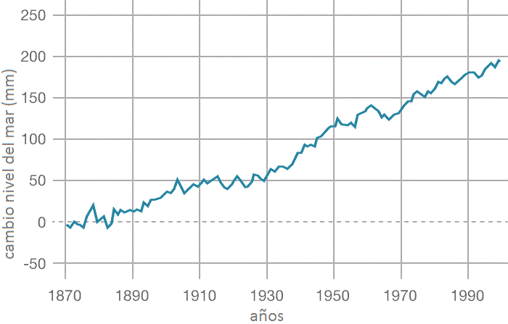
Satellite Data: from 1993 to present
Source: NASA Goddard Space Flight Center
Variation 3.4 ±0.4 mm per year:
Land data: 1870-2000
Tidal coastal records. Source: CSIRO

Slide 37
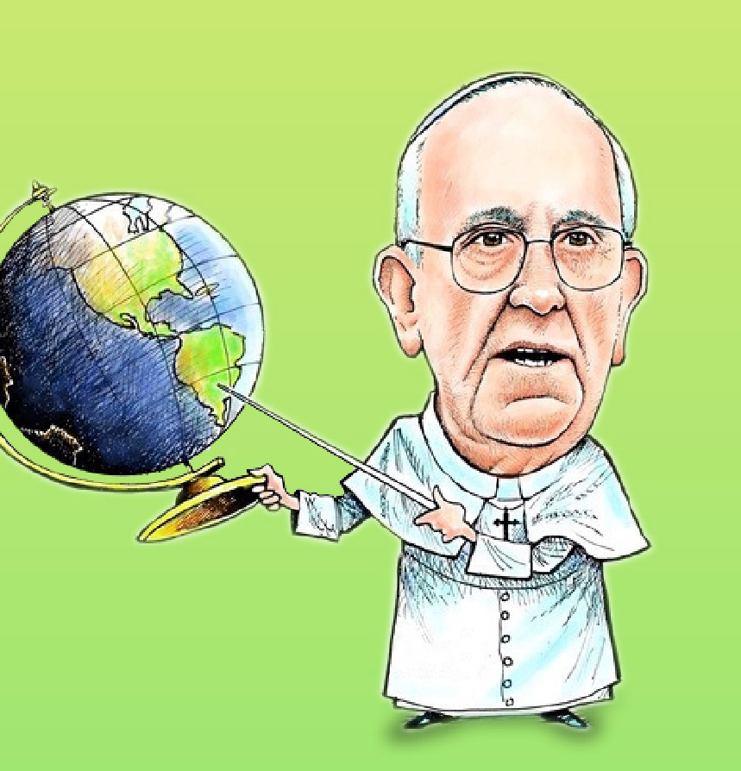
GLOBAL WARMING
“A very solid scientific consensus indicates that we are presently witnessing a disturbing warming of the climatic system” (LS 23)
AND
“It represents one of the principal challenges facing humanity in our day”
THOUGH, it is MUCH WORSE
“Many of those who possess more resources and economic or political power seem mostly to be concerned with masking the problems or concealing their symptoms, simply making efforts to reduce some of the negative impacts of climate change.” (LS 26).

Slide 38
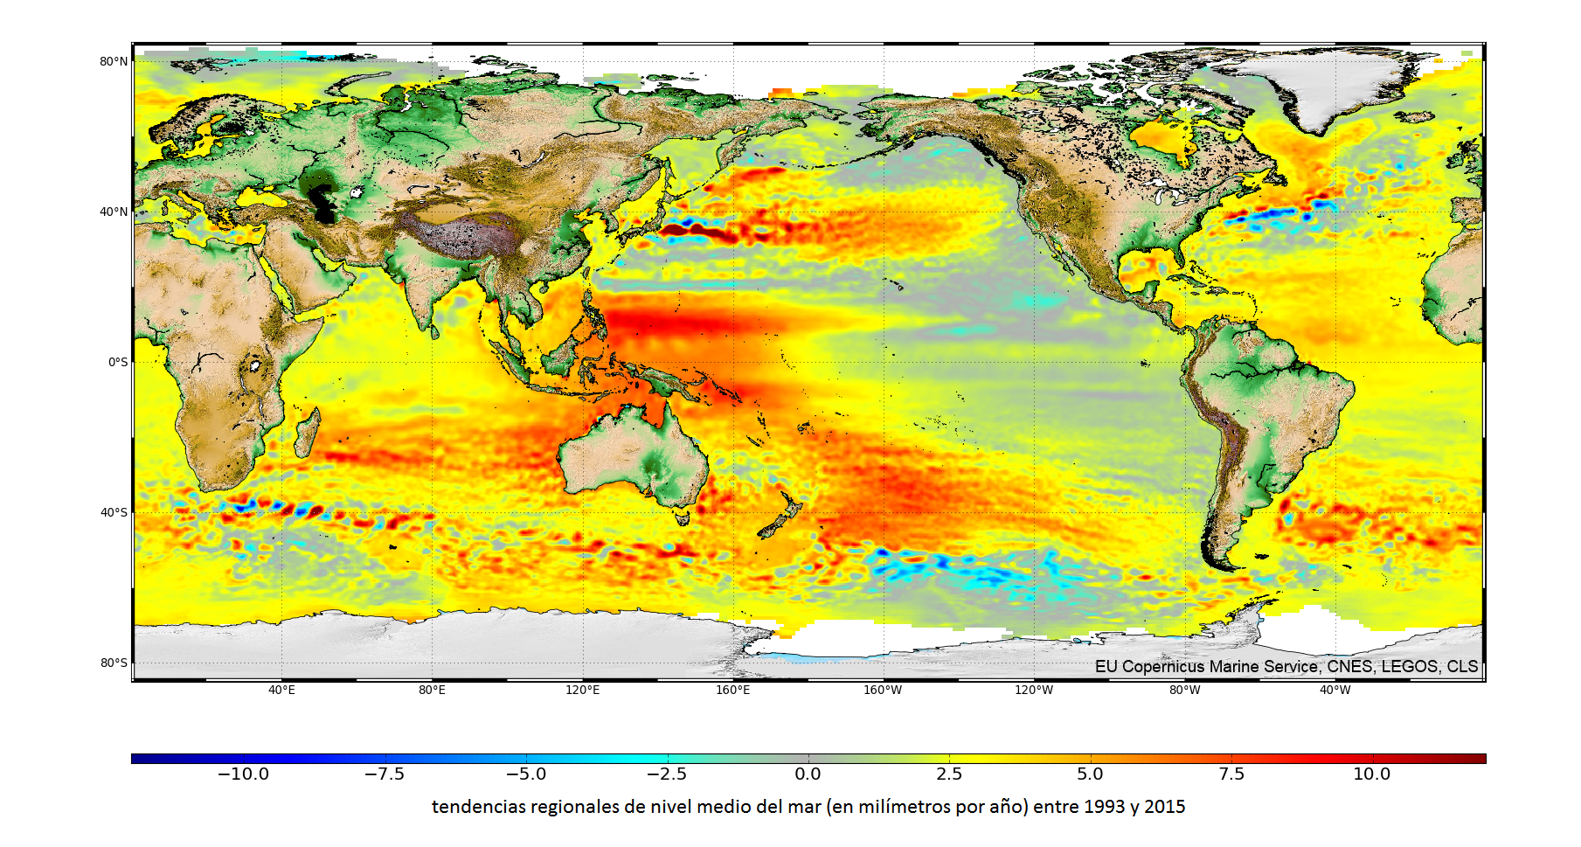
EVERYTHING IS INTERCONNECTED
“Today, however, we have to realize that a true ecological approach always becomes a social approach; it must integrate questions of justice in debates on the environment, so as to hear both the cry of the earth and the cry of the poor.” (LS 49)
The groaning of sister Earth, which joins the groaning of the abandoned of the world, with a cry that demands another course (cf. LS 50).
GLOBAL MEAN SEA LEVEL RISE

Slide 39
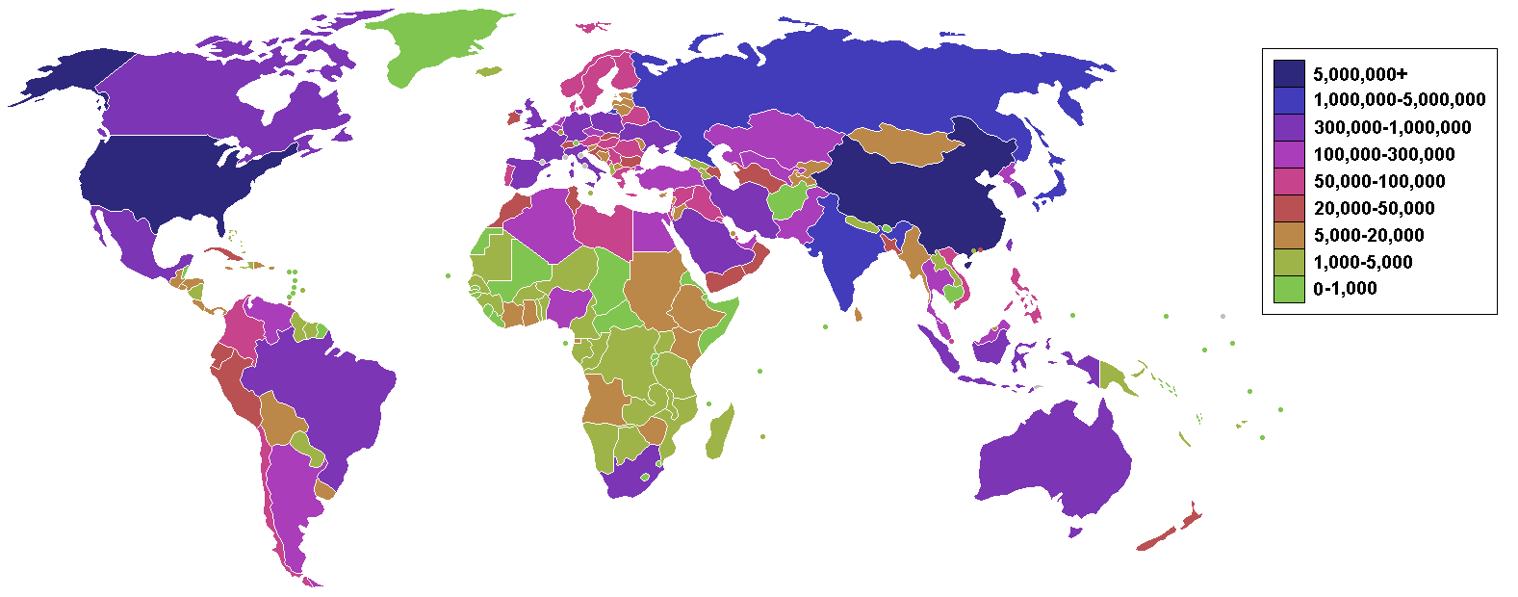
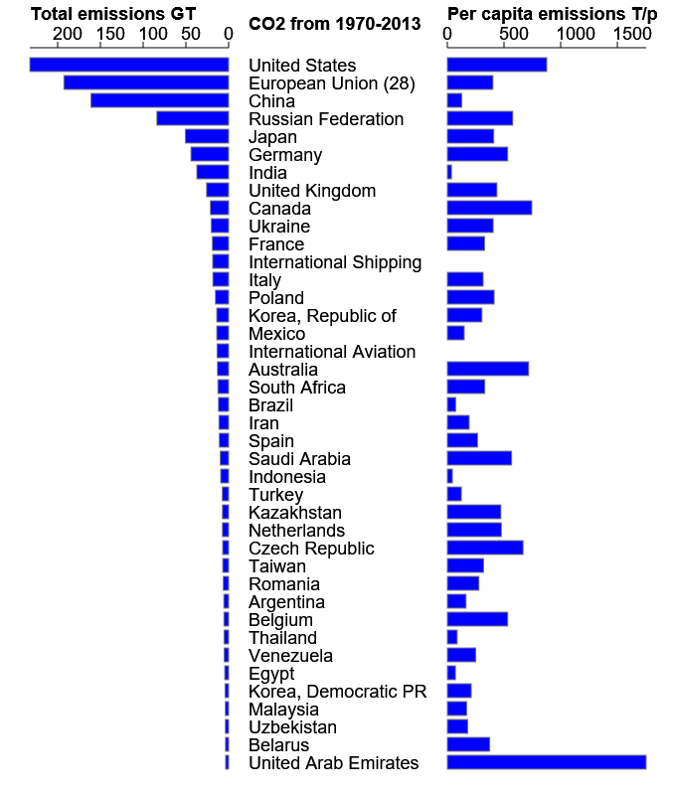
Countries that most emit CO2
Emitimos el 0.88% del total global. Es poco, pero es creciente y mayor a la media global.
La emisión per cápita es notable: estamos en la lista de los violetas
Notes:
The contents of this article comes from the latest figures from the millennium indicators as of 2009-07-14
United Nation Statistics Division
GHG data from UNFCCC - United Nations Framework Convention on Climate Change GHG emissions data
Breathing Earth - A visual real-time simulation that uses this CO₂ emissions data
Google - public data "CO₂ emissions (kt)"
Google - public data "CO₂ emissions (tonne per capita)"
World CO2 Emissions | Tableau Public

Slide 40
Science consensus on
The science is clear: global warming is driven by greenhouse-gas emissions which are the result of burning fossil fuels.
1
If we fail to strongly reduce these emissions and to bend the warming curve, we human beings will be exposed to intolerable risks.
2
We must note that the big issue rather than the amplitude of the warming in the future is the speed of the process.
3

Slide 41
Climate change poses risks to people and ecosystems by exacerbating existing economic, environmental, health and societal threats, and generating new ones.
These risks increase disproportionately as the temperature increases.
Many systems are already at risk from climate change.
A rise of 2°C above pre-industrial levels would lead to further increased risk from extreme weather and would place more ecosystems and cultures in significant danger.
At a rise of above 4°C, the risks include substantial species extinction, global and regional food insecurity, and fundamental changes to human activities that today are taken for granted.
HOW FAR ARE WE NOW FROM THESES THRESHOLDS?

Slide 42
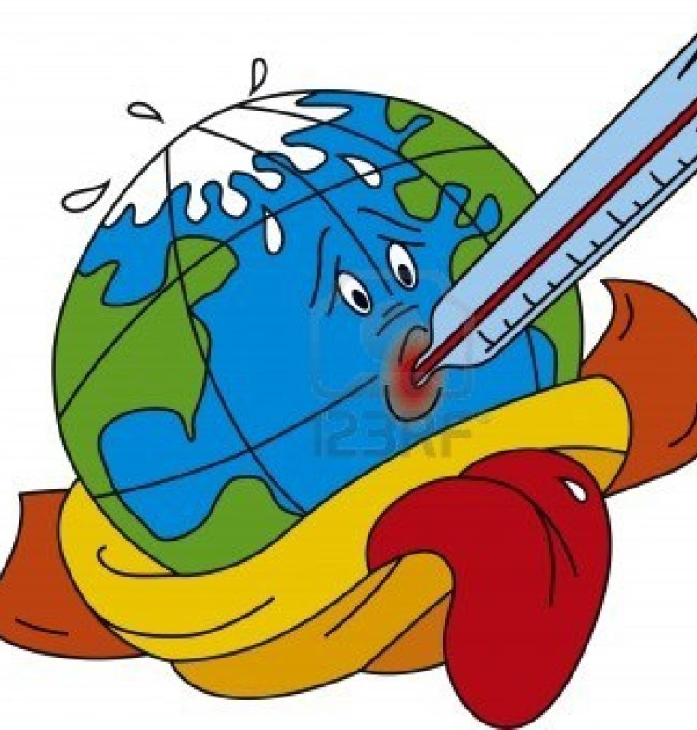
2016 are record! 2018, the 4th warmest!
GMST anomalies over
1.1°-1.3°C

Slide 43
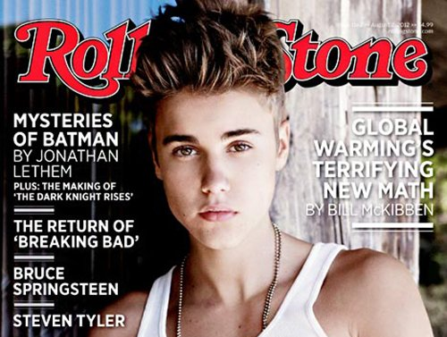
5. Why do we do nothing yet to solve it?
Basically because of money (article published by the Rolling Stone magazine)
To keep the climate well below 2°C of warming, we can emit no more than 565 gigatons (5.65x10¹⁴ kg) of CO2 alongside the course of the current century (to stay reasonable safe)
Oil companies have estimated their sustainability based on revenues from current conventional fossil fuel reserves, which if they were burnt it is estimated it will easily release 2795 giga tons of CO2 in the period.
http://www.rollingstone.com/politics/news/global-warmings-terrifying-new-math-20120719; Author: Bill McKibben, EEUU, julio 2012
i.e., five times higher than the threshold of safe warming adopted by the Paris Agreement.
i.e., about 80% of fossil fuel reservoirs must be kept there underground to fulfill the Paris Agreement.
Oil lobby is influencing political decisions to abort the International statement, and financing disinformation of media and the general public.

Slide 44
6. What can we do?
Change your pattern of consumption
(social logic of disposables, the throw-away culture)
Change your investment choices:
Stop fostering and investing money in oil-extractive industries as currently done.
Foster investment in alternative clean energies to lower their current price, as new better “business”
Support or joint a civil social organization (NGO) to advocate on Global Climate Justice
Obvious, simple things
Recycle, use it until it ends its useful life. (cf. LS 22, 26, 192)
Be energy efficient (cf. LS 26, 164, 180, 192)
Use public transport instead of your car (cf. LS 26, 58)
Walk
Ecc.

Slide 45
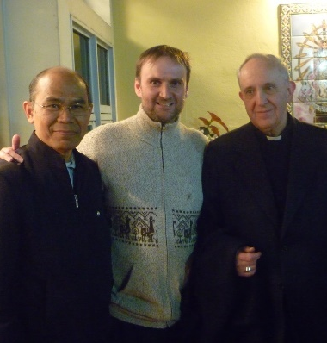
Thank you!
“We need to strengthen the conviction that we are one single human family. There are no frontiers or barriers, political or social, behind which we can hide, still less is there room for the globalization of indifference” (LS 51)

